Slide 1
CS 5683: Algorithms & Methods for Big Data Analytics Recommender Systems: Content-based Systems & Collaborative Filtering
Arunkumar Bagavathi
Department of Computer Science
Oklahoma State university

Slide 2
Course Topics Until Now
Frameworks
High. Dim. Data
Applications
Map Reduce
Locality Sensitive Hashing
Association Rules
Dimensionality Reduction
Spark
Recommender Systems
Clustering

Slide 3

Example Recommender Systems
Customer X
Buys Origin book
Buys Inferno CD
Customer Y
Does search on Origin
Recommender system suggests Inferno from data collected about customer X

Slide 4










Recommendations
Examples:
Search
Recommendations
Items
Products, web sites, blogs, news items, …

Slide 5
From Scarcity to Abundance
Shelf space is a scarce commodity for traditional retailers
Also: TV networks, movie theaters,…
Web enables near-zero-cost dissemination of information about products
From scarcity to abundance
Give raise to long tail phenomenon
More choice necessitates better filters
Recommendation engines
How Into Thin Air made Touching the Void a bestseller: http://www.wired.com/wired/archive/12.10/tail.html
Similarly, the movie Contagion become famous again after 11 years during the pandemic0

Slide 6
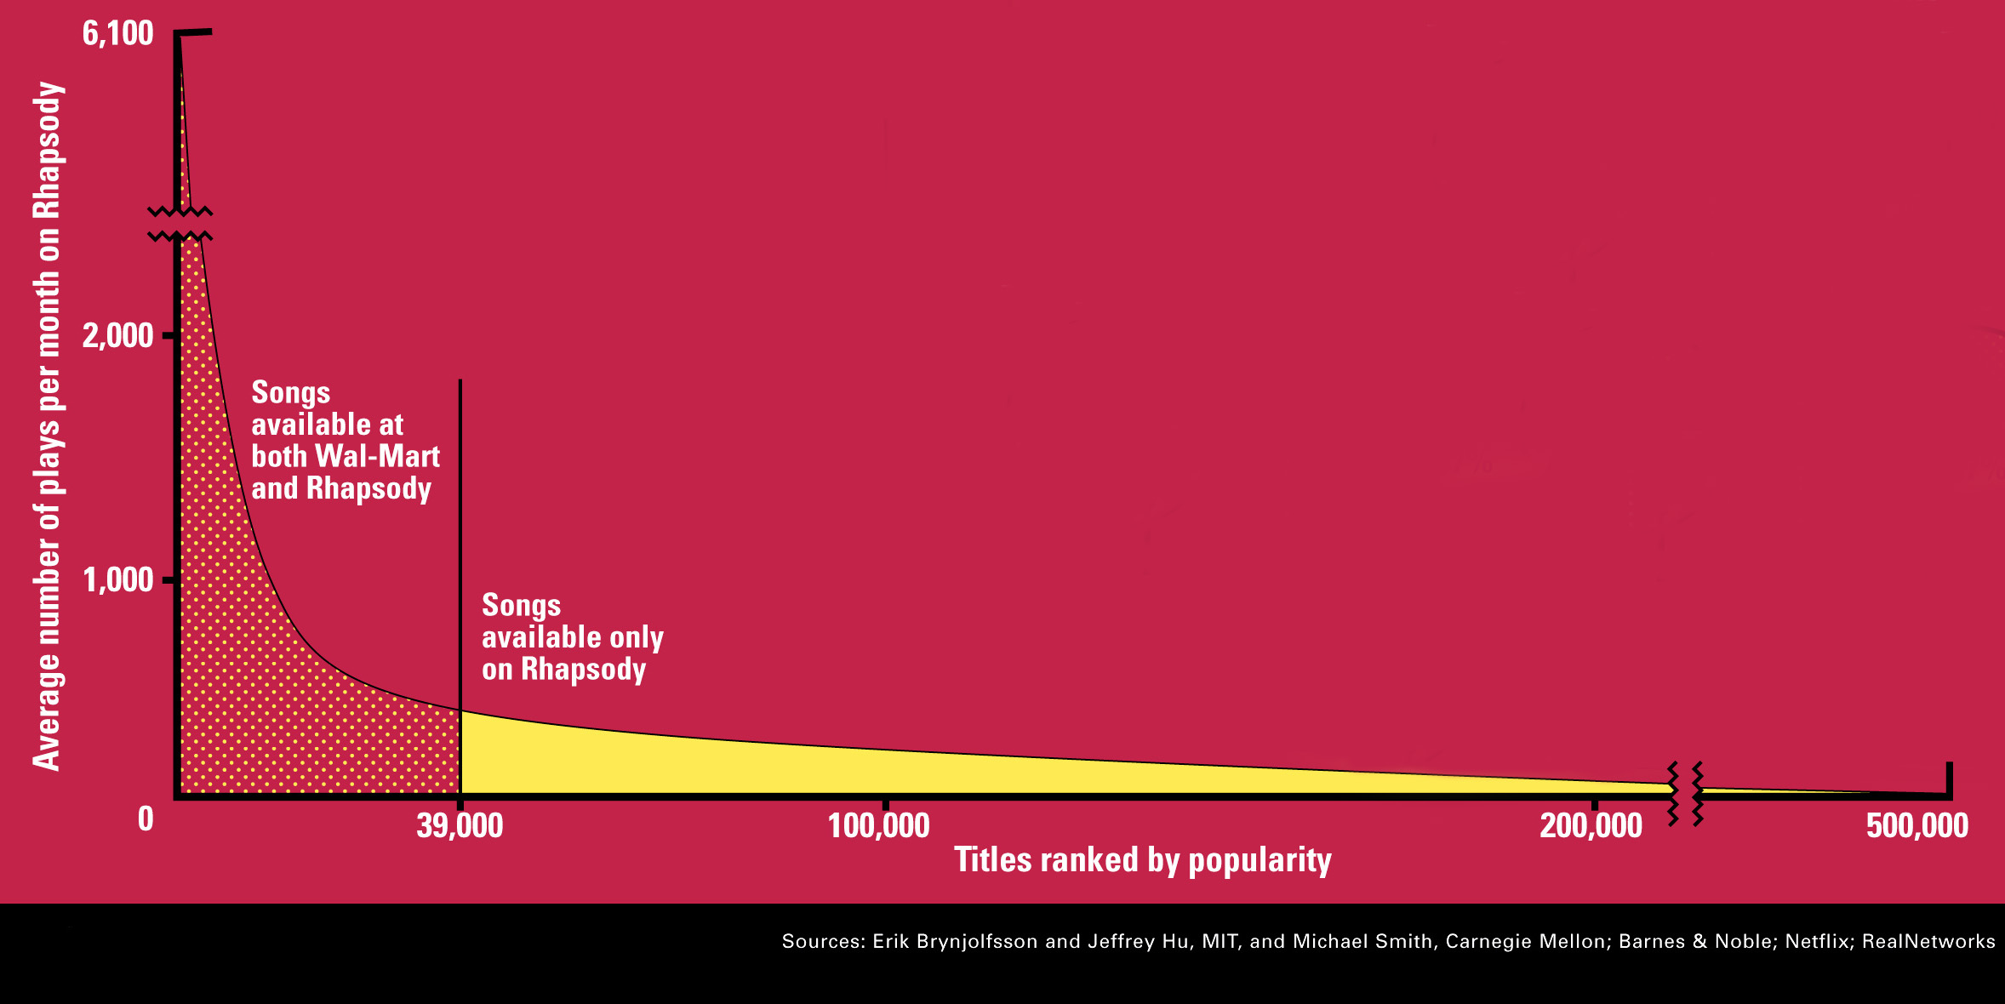
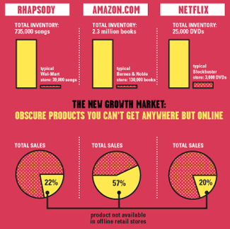
Sidenote: The Long Tail

Slide 7
Types of Recommendations
Editorial and hand curated
List of favorites
Lists of “essential” items
Simple aggregates
Top 10, Most Popular, Recent Uploads
Tailored to individual users
Amazon, Netflix, …

Slide 8
Formal Recommender Model
X = set of Customers
S = set of Items
Utility function u: X × S → R
R = set of ratings
R is a totally ordered set
e.g., 0-5 stars, real number in [0,1]

Slide 9
Utility Matrix
Avatar
LOTR
Matrix
Pirates
Alice
Bob
Carol
David

Slide 10
Key Problems
(1) Gathering “known” ratings for matrix
How to collect the data in the utility matrix?
(2) Extrapolate unknown ratings from the known ones
Mainly interested in high unknown ratings
We are not interested in knowing what you don’t like but what you like
(3) Evaluating extrapolation methods
How to measure success/performance of recommendation methods?

Slide 11
(1) Gathering Ratings
Explicit
Ask people to rate items
Doesn’t work well in practice – people can’t be bothered
Implicit
Learn ratings from user actions
E.g., purchase implies high rating
What about low ratings?

Slide 12
(2) Extrapolating Utilities
Key problem: Utility matrix U is sparse
Most people have not rated most items
Cold start:
New items have no ratings
New users have no history
Three approaches to recommender systems:
1) Content-based
2) Collaborative
3) Latent factor based

Slide 13
(1) Content-based Recommender Systems
Main idea: Recommend items to customer x similar to previous items rated highly by x
Example:
Movie recommendations
Recommend movies with same actor(s), director, genre, …
Websites, blogs, news
Recommend other sites with “similar” content

Slide 14
Plan of Action
Item profiles
likes
build
recommend
match
Red
Circles
Triangles
User profile

Slide 15
Item Profiles
For each item, create an item profile
Profile is a set (vector) of features
Movies: author, title, actor, director,…
Text: Set of “important” words in document
People: Set of friends
How to pick important features?
Usual heuristic from text mining is TF-IDF (Term frequency * Inverse Doc Frequency)
Term … Feature
Document … Item

Slide 16
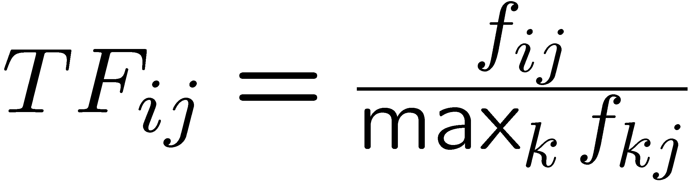
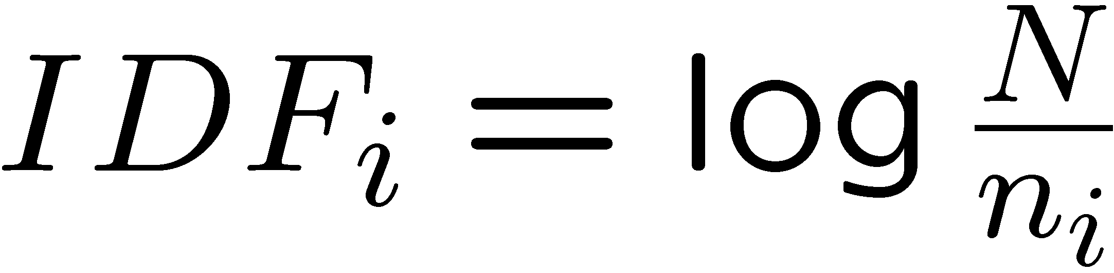
Sidenote: TF-IDF
f_{ij} = frequency of term (feature) i in doc (item) j
n_{i} = number of docs that mention term i
N = total number of docs
TF-IDF score: w_{ij} = TF_{ij} × IDF_{i}
Doc profile = set of words with highest TF-IDF scores, together with their scores
Note: we normalize TF to discount for “longer” documents

Slide 17
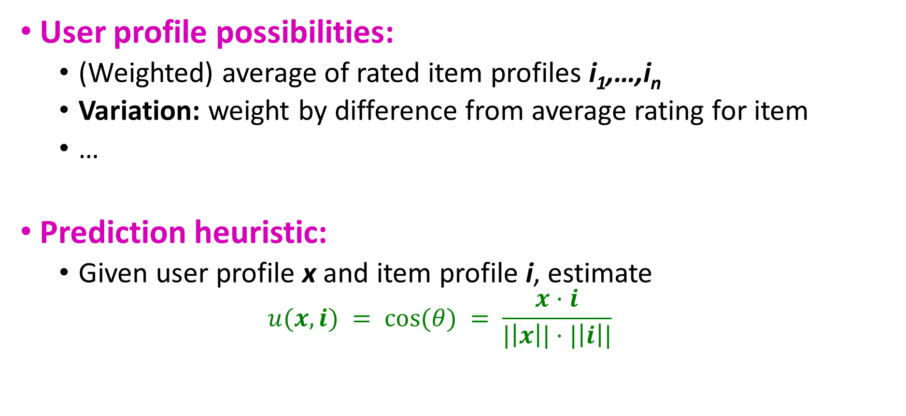
User Profiles and Prediction
User profile possibilities:
(Weighted) average of rated item profiles i₁,…,i_{n}
Variation: weight by difference from average rating for item
…
Prediction heuristic:
Given user profile x and item profile i, estimate
$$u(x,i) = cos⁡(θ) = \frac{x·i}{|\left|x\right||⋅|\left|i\right||}$$
x
ϴ
i

Slide 18
Pros: Content-based Approach
+: No need for data on other users
No sparsity problems
+: Able to recommend to users with unique tastes
+: Able to recommend new & unpopular items
No first-rater problem
+: Able to provide explanations
Can provide explanations of recommended items by listing content-features that caused an item to be recommended

Slide 19
Cons: Content-based Approach
–: Finding the appropriate features is hard
E.g., images, movies, music
–: Recommendations for new users
How to build a user profile?
–: Overspecialization
Never recommends items outside user’s content profile
People might have multiple interests
Unable to exploit quality judgments of other users

Slide 20
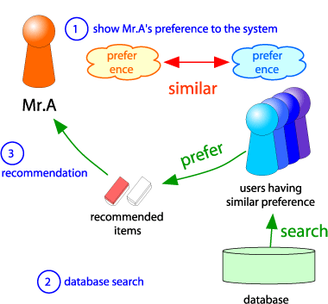
(2) Collaborative Filtering
Harness quality judgement of other users
Consider user X
Find a set N of other users whose ratings are “similar” to X’s ratings
Estimate X’s ratings based on ratings of users in N
x
N

Slide 21
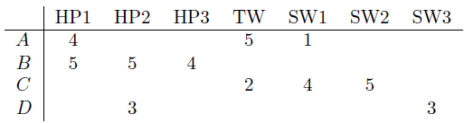
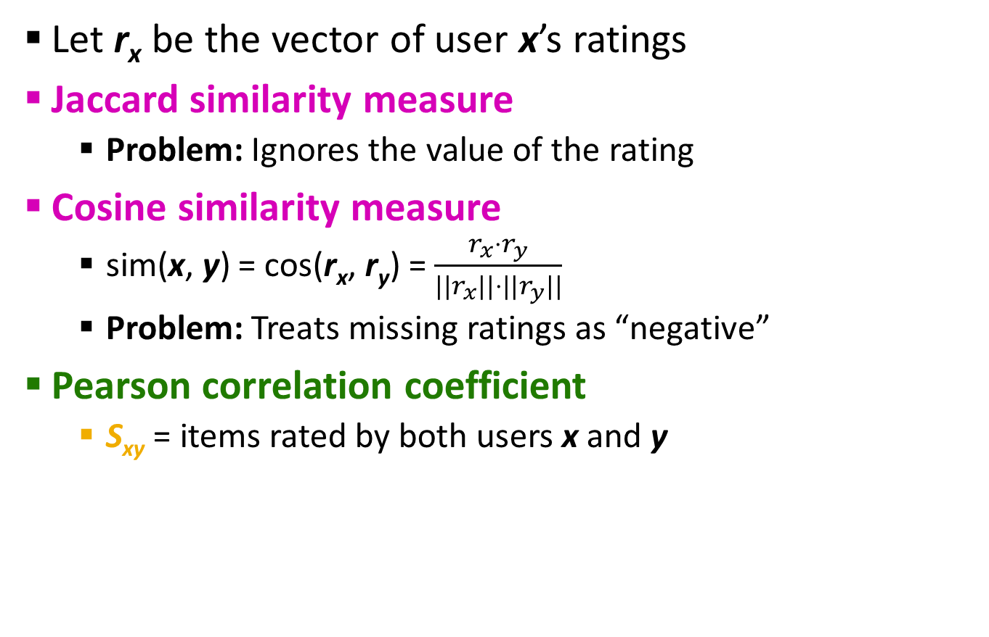
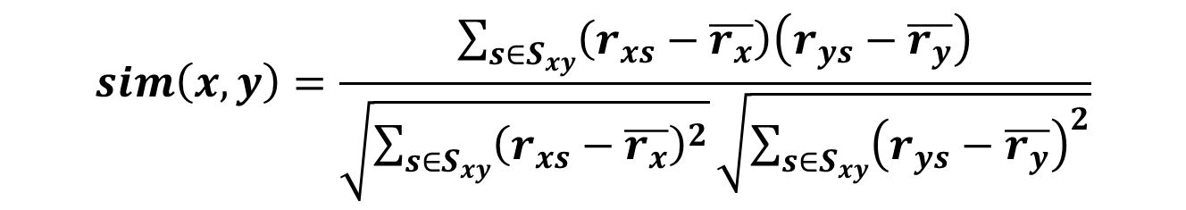
Finding “Similar” Users
r_{x} = [*, _, _, *, ***]
r_{y} = [*, _, **, **, _]
Let r_{x} be the vector of user x’s ratings
Jaccard similarity measure
Problem: Ignores the value of the rating
Cosine similarity measure
sim(x, y) = cos(r_{x}, r_{y}) = $\frac{r_{x}⋅r_{y}}{||r_{x}||⋅{||r}_{y}||}$
Problem: Treats missing ratings as “negative”
Pearson correlation coefficient
S_{xy} = items rated by both users x and y
r_{x}, r_{y} as sets:
r_{x} = {1, 4, 5}
r_{y} = {1, 3, 4}
r_{x}, r_{y} as points:
r_{x} = {1, 0, 0, 1, 3}
r_{y} = {1, 0, 2, 2, 0}
$$sim\left(x,y\right)=\frac{\sum_{s∈S_{xy}}{\left(r_{xs}−\overline{r_{x}}\right)\left(r_{ys}−\overline{r_{y}}\right)}}{\sqrt{\sum_{s∈S_{xy}}{{\left(r_{xs}−\overline{r_{x}}\right)}^{2}}}\sqrt{\sum_{s∈S_{xy}}{{\left(r_{ys}−\overline{r_{y}}\right)}^{2}}}}$$
r_{x}, r_{y} … avg. rating of x, y

Slide 22
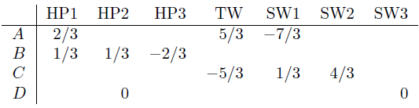
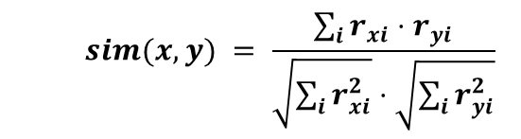
Similarity Metric
$$sim(x, y) = \frac{\sum_{i}{r_{xi}⋅r_{yi}}}{\sqrt{\sum_{i}{r_{xi}^{2}}}⋅\sqrt{\sum_{i}{r_{yi}^{2}}}}$$
Intuitively we want: sim(A, B) > sim(A, C)
Jaccard similarity: 1/5 < 2/4
Cosine similarity: 0.386 > 0.322
Considers missing ratings as “negative”
Solution: normalize by subtracting the (row) mean – centered cosine similarity / pearson correlation
sim A,B vs. A,C:
0.092 > -0.559
Notice cosine sim. is correlation when data is centered at 0
Notes:
Avg. rating of A = 10/3 ➔ 4-10/3=2/3
Avg. rating of B = 14/3
Avg. rating of A = 11/3

Slide 23
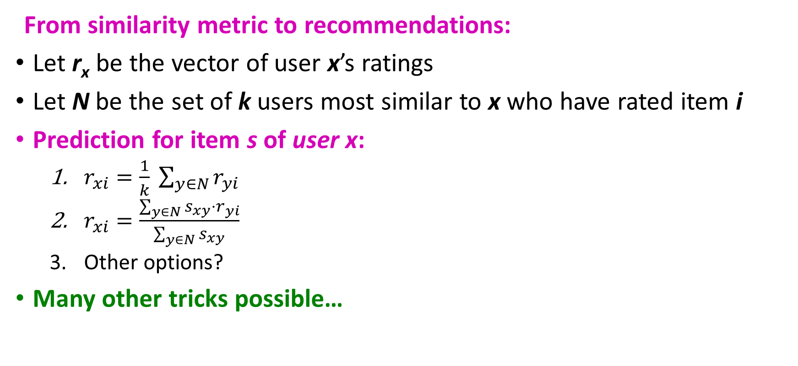
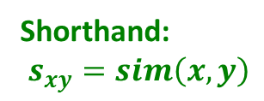
Rating Predictions
From similarity metric to recommendations:
Let r_{x} be the vector of user x’s ratings
Let N be the set of k users most similar to x who have rated item i
Prediction for item s of user x:
$r_{xi}=\frac{1}{k} \sum_{y∈N}{r_{yi}}$
$r_{xi}=\frac{\sum_{y∈N}{s_{xy}⋅r_{yi}}}{\sum_{y∈N}{s_{xy}}}$
Other options?
Many other tricks possible…
Shorthand: $s_{xy}=sim\left(x,y\right)$

Slide 24
Item-Item Collaborative Filtering
So far: User-user collaborative filtering
Another view: Item-item
For item i, find other similar items
Estimate rating for item i based on ratings for similar items
Can use same similarity metrics and prediction functions as in user-user model
s_{ij}… similarity of items i and j
r_{xj}…rating of user u on item j
N(i;x)… set items rated by x similar to i

Slide 25
Item-Item Collaborative Filtering (|N|=2)
12 | 11 | 10 | 9 | 8 | 7 | 6 | 5 | 4 | 3 | 2 | 1
 | 4 |  | 5 |  |  | 5 |  |  | 3 |  | 1 | 1
3 | 1 | 2 |  |  | 4 |  |  | 4 | 5 |  |  | 2
 | 5 | 3 | 4 |  | 3 |  | 2 | 1 |  | 4 | 2 | 3
 | 2 |  |  | 4 |  |  | 5 |  | 4 | 2 |  | 4
5 | 2 |  |  |  |  | 2 | 4 | 3 | 4 |  |  | 5
 | 4 |  |  | 2 |  |  | 3 |  | 3 |  | 1 | 6
movies
- unknown rating
- rating between 1 to 5

Slide 26
Item-Item Collaborative Filtering (|N|=2)
12 | 11 | 10 | 9 | 8 | 7 | 6 | 5 | 4 | 3 | 2 | 1
 | 4 |  | 5 |  |  | 5 | ? |  | 3 |  | 1 | 1
3 | 1 | 2 |  |  | 4 |  |  | 4 | 5 |  |  | 2
 | 5 | 3 | 4 |  | 3 |  | 2 | 1 |  | 4 | 2 | 3
 | 2 |  |  | 4 |  |  | 5 |  | 4 | 2 |  | 4
5 | 2 |  |  |  |  | 2 | 4 | 3 | 4 |  |  | 5
 | 4 |  |  | 2 |  |  | 3 |  | 3 |  | 1 | 6
movies
- Estimate rating of movie 1 by user 5

Slide 27
Item-Item Collaborative Filtering (|N|=2)
users
12 | 11 | 10 | 9 | 8 | 7 | 6 | 5 | 4 | 3 | 2 | 1
 | 4 |  | 5 |  |  | 5 | ? |  | 3 |  | 1 | 1
3 | 1 | 2 |  |  | 4 |  |  | 4 | 5 |  |  | 2
 | 5 | 3 | 4 |  | 3 |  | 2 | 1 |  | 4 | 2 | 3
 | 2 |  |  | 4 |  |  | 5 |  | 4 | 2 |  | 4
5 | 2 |  |  |  |  | 2 | 4 | 3 | 4 |  |  | 5
 | 4 |  |  | 2 |  |  | 3 |  | 3 |  | 1 | 6
sim(1,m)
1.00
-0.18
0.41
-0.10
-0.31
0.59
movies
Neighbor selection: Identify movies similar to movie 1, rated by user 5
Here we use Pearson correlation as similarity:
1) Subtract mean rating m_{i} from each movie i m₁ = (1+3+5+5+4)/5 = 3.6 row 1: [-2.6, 0, -0.6, 0, 0, 1.4, 0, 0, 1.4, 0, 0.4, 0]
2) Compute cosine similarities between rows

Slide 28
Item-Item Collaborative Filtering (|N|=2)
users
12 | 11 | 10 | 9 | 8 | 7 | 6 | 5 | 4 | 3 | 2 | 1
 | 4 |  | 5 |  |  | 5 | ? |  | 3 |  | 1 | 1
3 | 1 | 2 |  |  | 4 |  |  | 4 | 5 |  |  | 2
 | 5 | 3 | 4 |  | 3 |  | 2 | 1 |  | 4 | 2 | 3
 | 2 |  |  | 4 |  |  | 5 |  | 4 | 2 |  | 4
5 | 2 |  |  |  |  | 2 | 4 | 3 | 4 |  |  | 5
 | 4 |  |  | 2 |  |  | 3 |  | 3 |  | 1 | 6
sim(1,m)
1.00
-0.18
0.41
-0.10
-0.31
0.59
movies
Compute similarity weights: s_{1,3}=0.41, s_{1,6}=0.59

Slide 29
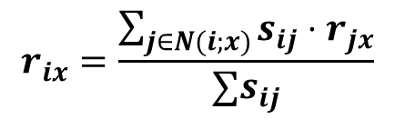
Item-Item Collaborative Filtering (|N|=2)
users
12 | 11 | 10 | 9 | 8 | 7 | 6 | 5 | 4 | 3 | 2 | 1
 | 4 |  | 5 |  |  | 5 | 2.6 |  | 3 |  | 1 | 1
3 | 1 | 2 |  |  | 4 |  |  | 4 | 5 |  |  | 2
 | 5 | 3 | 4 |  | 3 |  | 2 | 1 |  | 4 | 2 | 3
 | 2 |  |  | 4 |  |  | 5 |  | 4 | 2 |  | 4
5 | 2 |  |  |  |  | 2 | 4 | 3 | 4 |  |  | 5
 | 4 |  |  | 2 |  |  | 3 |  | 3 |  | 1 | 6
movies
Predict by taking weighted average:
r_{1.5} = (0.41*2 + 0.59*3) / (0.41+0.59) = 2.6
$$r_{ix}=\frac{\sum_{j∈N(i;x)}{s_{ij}⋅r_{jx}}}{∑s_{ij}}$$

Slide 30

Collaborative Filtering: Common Practice
Before:
Define similarity s_{ij} of items i and j
Select k nearest neighbors N(i; x)
Items most similar to i, that were rated by x
Estimate rating r_{xi} as the weighted average:
baseline estimate for r_{xi}
μ = overall mean movie rating
b_{x} = rating deviation of user x
= (avg. rating of user x) – μ
b_{i} = rating deviation of movie i
$$b_{xi}=μ+b_{x}+b_{i}$$

Slide 31
Item-Item Vs. user-User
Avatar
LOTR
Matrix
Pirates
Alice
Bob
Carol
David
In practice, it has been observed that item-item often works better than user-user
Why? Items are simpler, users have multiple tastes

Slide 32
Pros/Cons of Collaborative Filtering
+: Works for any kind of items
No feature selection is requires
–: Cold start
Not enough users in the system to find a match
–: Sparsity
User/ratings matrix is sparse
Hard to find users that have rated same items
–: First rater
Cannot recommend an item that has not been previously rates
New items
–: Popularity bias
Cannot recommend an items to someone with unique taste
Tends to recommend popular items

Slide 33
Pros/Cons of hybrid Methods Filtering
Implement two or more different recommenders and combine predictions
Perhaps using a linear model
Add content-based methods to collaborative filtering
Item profiles for new item problem
Demographics to deal with new user problem

Slide 34
Remarks & Practical Tips - Evaluation
movies
1 | 3 | 4
 | 3 | 5 |  |  | 5
 |  | 4 | 5 |  | 5
 |  | 3
 |  | 3
2 |  |  | 2 |  | 2
 |  |  |  | 5
 | 2 | 1 |  |  | 1
 | 3 |  |  | 3
1
users

Slide 35
Remarks & Practical Tips - Evaluation
movies
1 | 3 | 4
 | 3 | 5 |  |  | 5
 |  | 4 | 5 |  | 5
 |  | 3
 |  | 3
2 |  |  | ? |  | ?
 |  |  |  | ?
 | 2 | 1 |  |  | ?
 | 3 |  |  | ?
1
users
Test Data Set

Slide 36
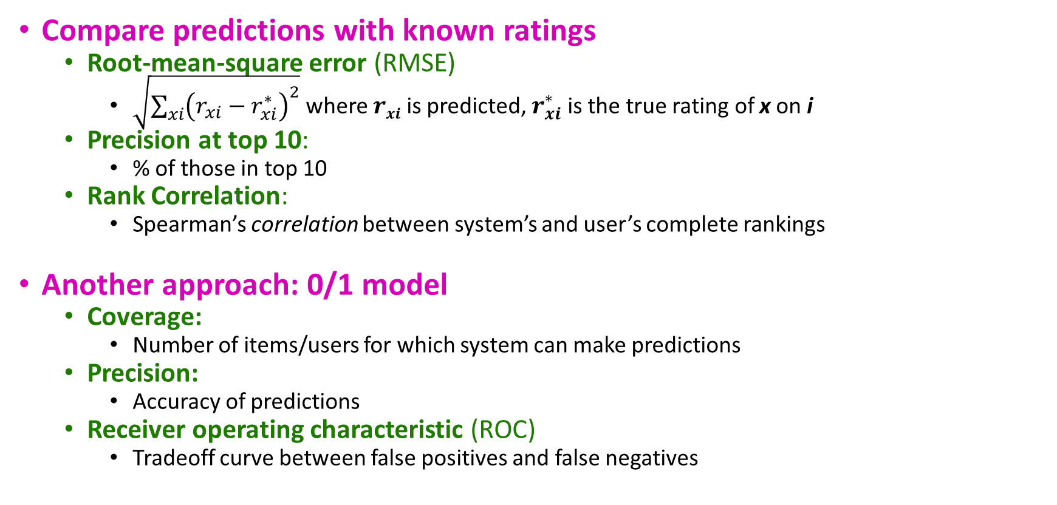
Evaluating Predictions
Compare predictions with known ratings
Root-mean-square error (RMSE)
$\sqrt{\sum_{xi}{{\left(r_{xi}−r_{xi}^{∗}\right)}^{2}}}$ where $rxi$ is predicted, $r_{xi}^{∗}$ is the true rating of x on i
Precision at top 10:
% of those in top 10
Rank Correlation:
Spearman’s correlation between system’s and user’s complete rankings
Another approach: 0/1 model
Coverage:
Number of items/users for which system can make predictions
Precision:
Accuracy of predictions
Receiver operating characteristic (ROC)
Tradeoff curve between false positives and false negatives

Slide 37
Problem with Error Measures
Narrow focus on accuracy sometimes misses the point
Prediction Diversity
Prediction Context
Order of predictions
In practice, we care only to predict high ratings:
RMSE might penalize a method that does well for high ratings and badly for others

Slide 38
Collaborative Filtering: Complexity
Expensive step is finding k most similar customers: O(|X|)
Too expensive to do at runtime
Could pre-compute
Naïve pre-computation takes time O(k ·|X|)
X … set of customers
We already know how to do this!
Near-neighbor search in high dimensions (LSH)
Clustering
Dimensionality reduction

Slide 39
Collaborative Filtering: Complexity
Leverage all the data
Don’t try to reduce data size in an effort to make fancy algorithms work
Simple methods on large data do best
Add more data
e.g., add IMDB data on genres
More data beats better algorithms
http://anand.typepad.com/datawocky/2008/03/more-data-usual.html

Slide 40

Questions???

Slide 41
Acknowledgements
Most of this lecture slides are obtained from the Mining Massive Datasets course: http://www.mmds.org/

